Slide 1

ECE 603 Probability and Random Processes
Lesson 4
Chapter 2
Counting Methods
Notes:
Now: Slides with Annotation
Next: Slides with Annotation
*****Preparation Notes*****
Students taking this course should already have covered linear algebra elsewhere.
We will use linear algebra extensively in this course.

Slide 2
Objectives
Examine counting as a result of the multiplication principle.
Apply the basic introductions of the material to probability.
Notes:
Now: Slides with Annotation
Next: Slides with Annotation

Slide 3
Rationale
Counting is necessary for solving some probability problems. This lesson will focus on methods for counting elements in an efficient manner.
Almost everything you need to know about counting comes from the multiplication principle.
This lesson will take what you previously reviewed about the Cartesian viewpoint and explore a different perspective.
Notes:
Now: Slides with Annotation
Next: Slides with Annotation

Slide 4
Prior Learning
Basic Concepts
Access to the online textbook: https://www.probabilitycourse.com/
Notes:
Now: Slides with Annotation
Next: Slides with Annotation

Slide 5


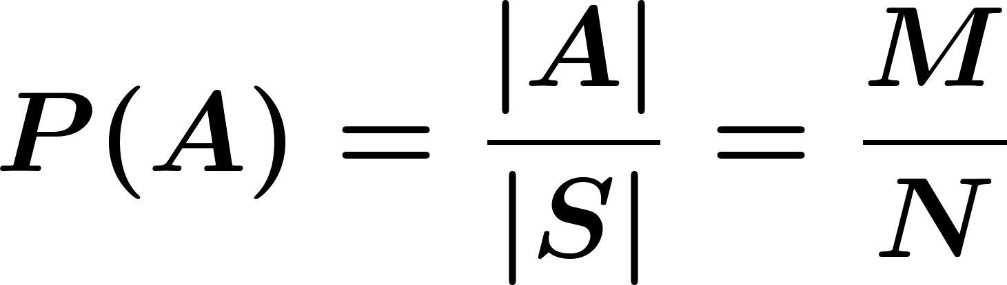
Counting Methods
For a finite sample space with equally likely outcomes, the probability of an event is given by

Slide 6





Counting Methods
Multiplication Principle:
If we are to perform experiments in order such that there are possible outcomes of the first experiment, possible outcomes of the second experiment, … , possible outcomes of the experiment, then there is a total of outcomes of the sequence of the experiments.

Slide 7
Counting Methods
Example:
A college planning committee consists of 3 freshmen, 4 sophomores, 5 juniors, and 2 Seniors. A subcommittee of one person from each class is to be chosen. How many different subcommittees are possible?

Slide 8
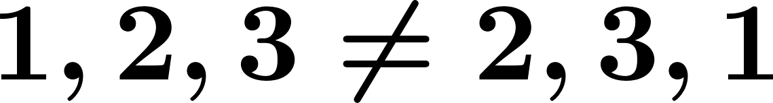
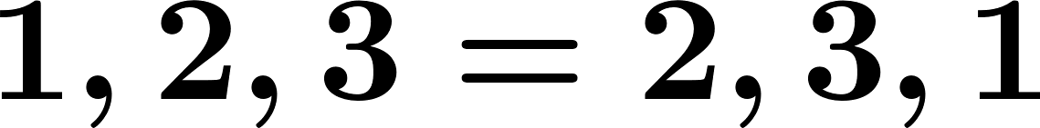
Counting Methods
Drawing (choosing) objects from a set is referred to as sampling.
We will often draw multiple samples from a set. If we put the object back after each draw, this is called sampling with replacement; if not it is called sampling without replacement.
The result of drawing multiple samples can be ordered (order of draws matters; ) or unordered ( ).

Slide 9



Counting Methods
General scenario:
We have a set of elements, e.g. , and we draw samples from the set:
With replacement
Ordered
Without replacement
Sampling
Without replacement
Unordered
With replacement

Slide 10
Counting Methods
Remember:

Slide 11
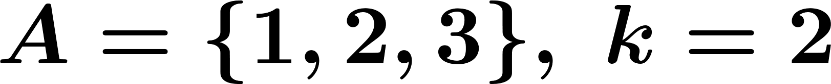
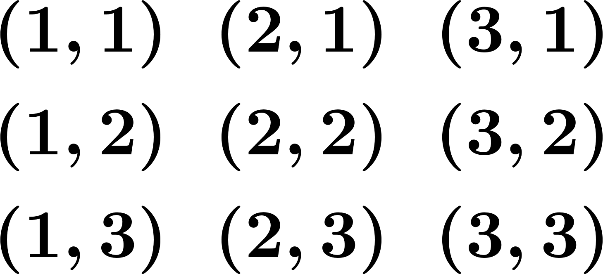




Counting Methods
For
Ordered Sampling with Replacement (repetition allowed)
In general:
Possibilities

Slide 12
Orchestrated Conversation: Counting Methods
Example:
How many different 7-place license plates are possible if the first 3 places are to be occupied by letters and the final 4 by numbers?

Slide 13
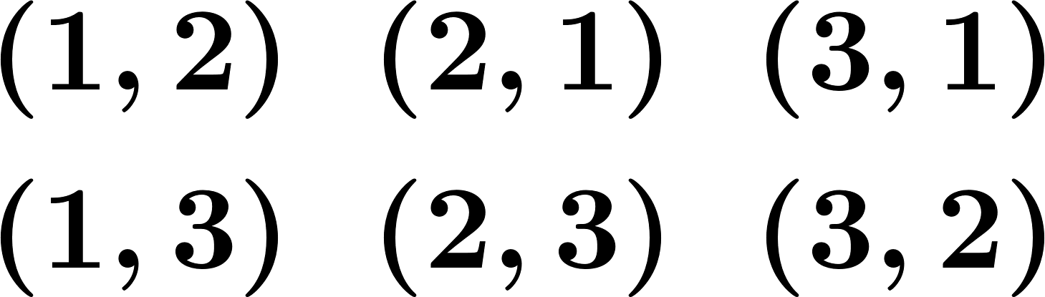




Counting Methods
Ordered Sampling without Replacement (repetition not allowed)
In general:
Possibilities

Slide 14
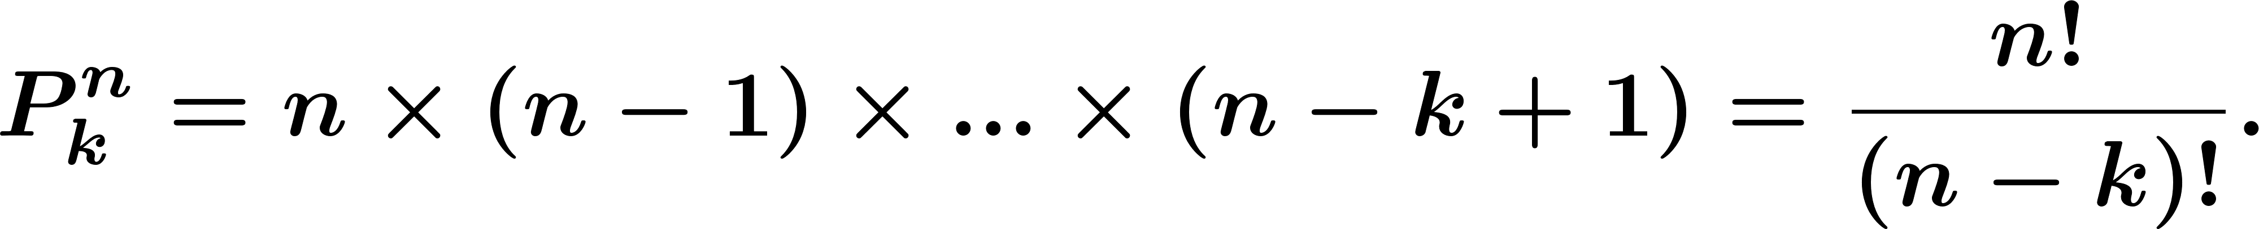
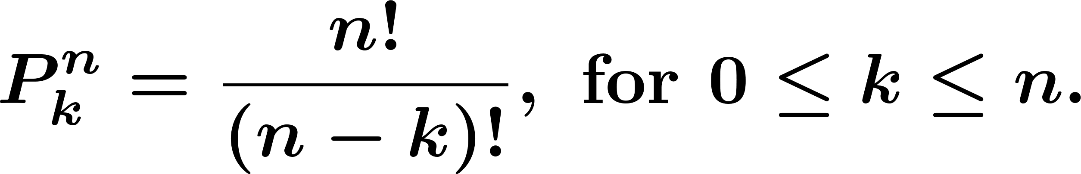
Counting Methods
Number of -permutations of -objects:
The number of -permutations of distinguishable objects is given by

Slide 15
Orchestrated Conversation: Counting Methods
Example:
(Birthday Paradox) In a group of people, what is the probability that at least two have the same birthday?

Slide 16



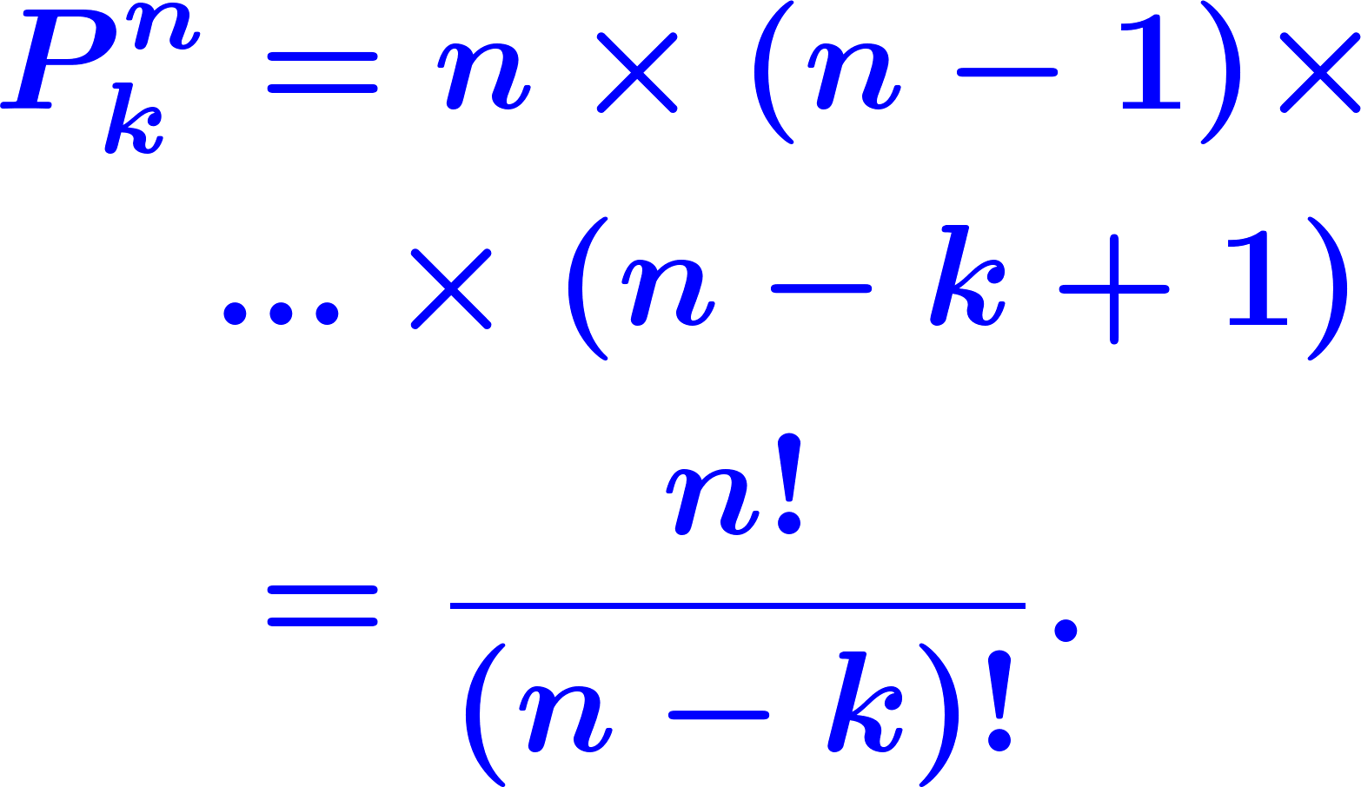
Counting Methods
Sample of size from
With replacement
Ordered
Without replacement
Sampling
Without replacement
Unordered
With replacement

Slide 17


Counting Methods
Unordered Sampling without Replacement (Combinations):
There are distinguishable objects; we want to choose objects, but ordering does not matter:
Let and then
possibilities

Slide 18
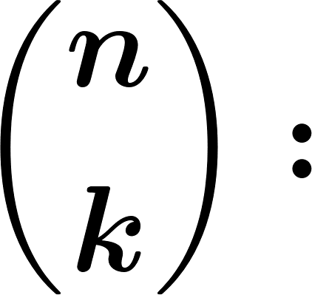
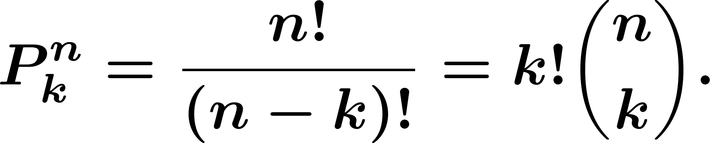
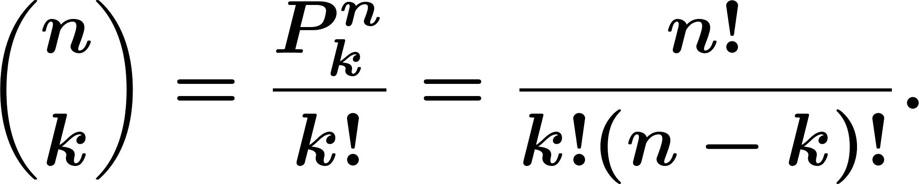
Counting Methods
In general:
# of ways to choose elements from elements (Unordered): -Combinations
If ordered:
If unordered:

Slide 19
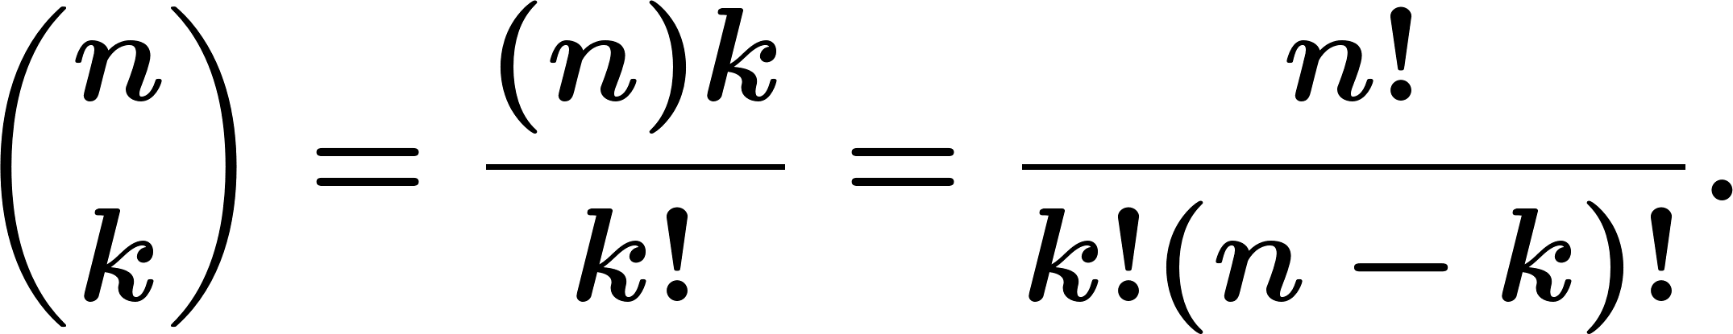
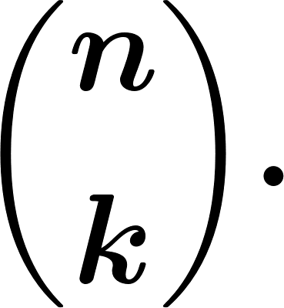
Counting Methods
Thus the number of -combinations of objects is:
The number of ways to choose objects out of distinguishable objects is equal to

Slide 20
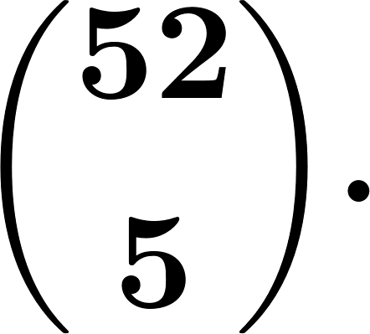
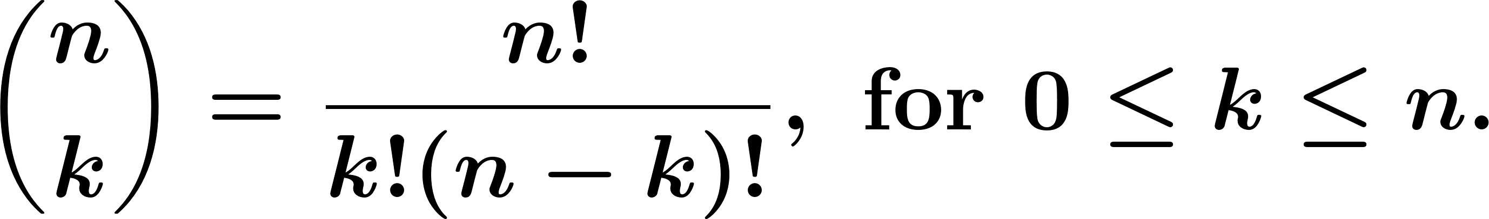
Counting Methods
Example.
The number of five-card poker hands is
The number of -combinations of an -element set is given by

Slide 21
Orchestrated Conversation: Counting Methods
Example.
A committee of 5 is to be selected from a group of 6 men and 9 women. If the selection is made randomly, what is the probability that the committee consists of 3 men and 2 women?

Slide 22
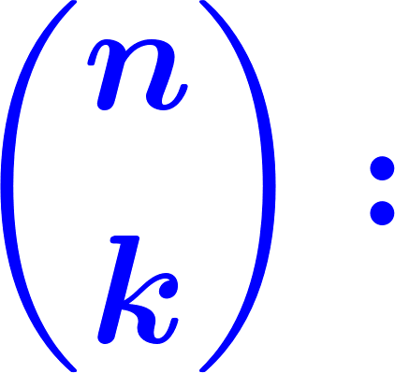

Orchestrated Conversation: Counting Methods
Another interpretation of
The number of possible divisions of n distinct objects to two groups of sets of sizes and is also equal to
Example: We toss a coin 5 times and observe the sequence of heads and tails. How many different outcomes are possible if we know two tails and three heads have been observed?

Slide 23

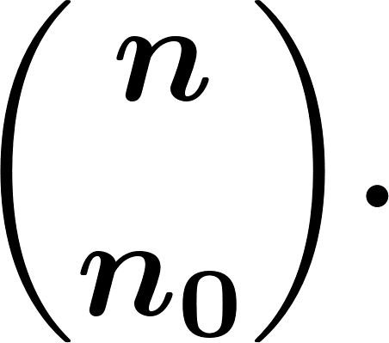

Counting Methods
The number of observation sequences for sub-experiments with the sample space with 0 appearing times and 1 appearing
times is
Example. How many distinct sequences can we make using 3 As and 5 Bs? (AAABBBBB, AABABBBB, ….)

Slide 24
Orchestrated Conversation: Counting Methods
Example. We toss a coin times and observe the sequence of heads and tails. How many different outcomes are possible if we know tails and heads have been observed?

Slide 25
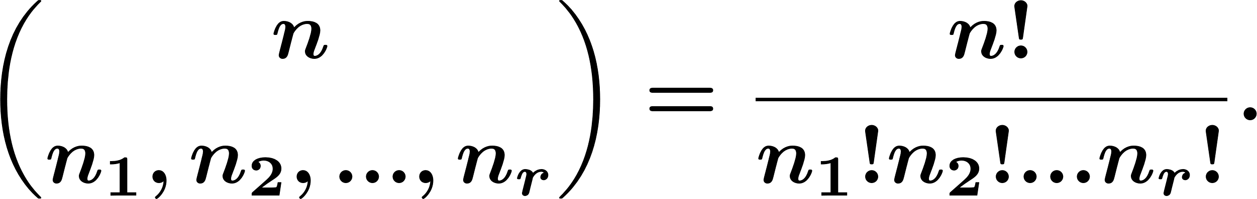


Counting Methods
Multinomial Coefficients: More generally if we define
is the number of possible divisions of distinct objects into distinct groups of respective sizes

Slide 26


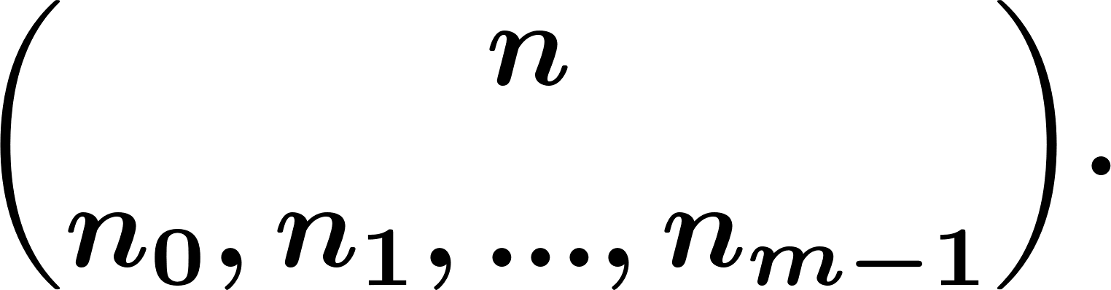
Counting Methods
Theorem. For repetitions of sub-experiment with sample space
the number of length observation sequences with appearing times is

Slide 27
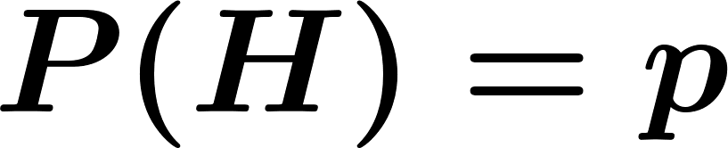
Counting Methods
Bernoulli Trials:
Example. We toss an unfair coin ( ) times. What is the probability of observing heads?

Slide 28

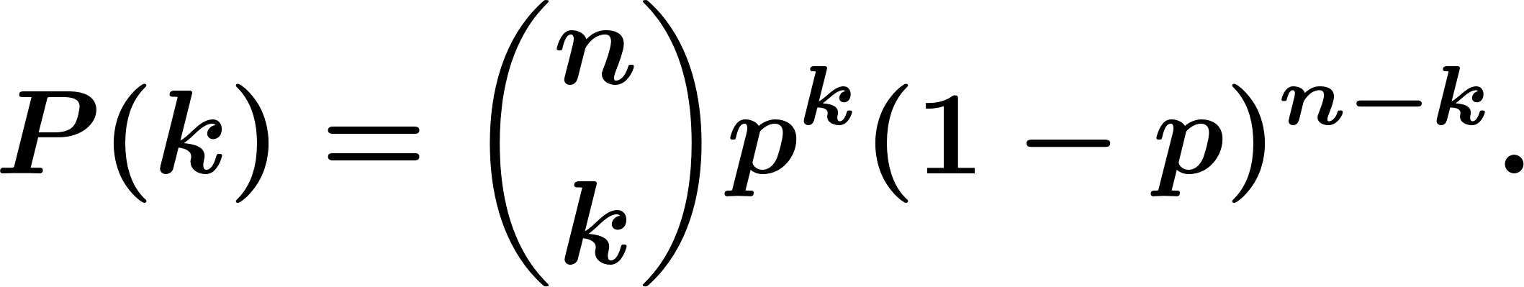
Counting Methods
Binomial Formula:
For independent Bernoulli trials where each trial has success probability the probability of successes is given by

Slide 29
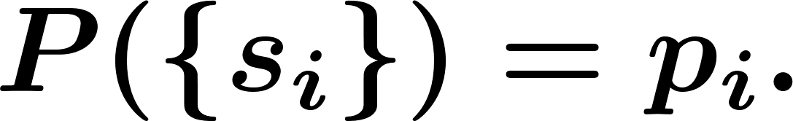
Counting Methods
Generally, assume the sub-experiment has sample space with For independent trials, the probability that appears times for all is

Slide 30
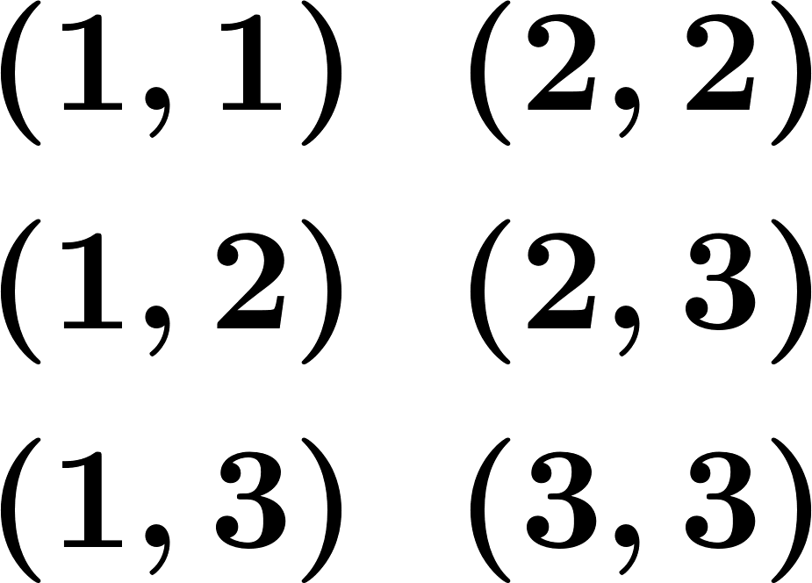

Counting Methods
Unordered Sampling with Replacement (repetition allowed):
Example:
Cases.

Slide 31
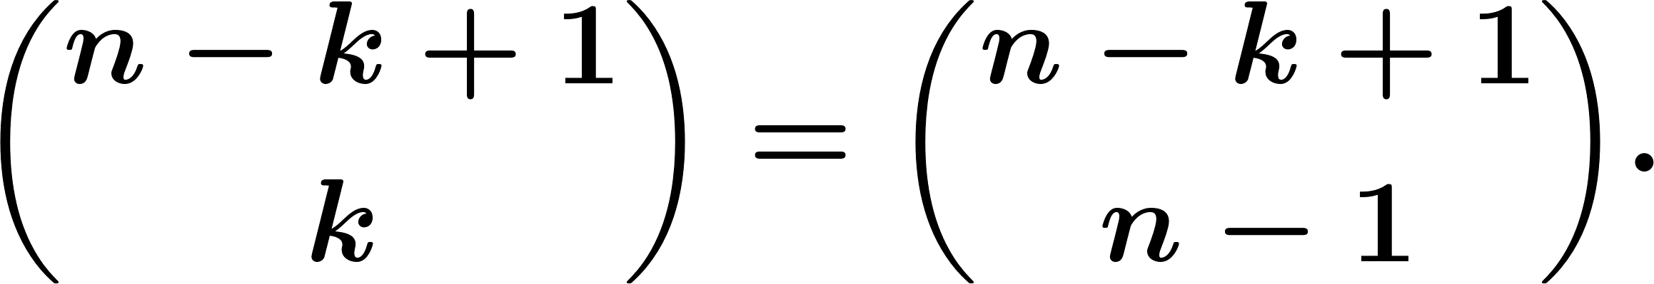
Counting Methods
Lemma.
The total number of distinct samples from an -element set such that repetition is allowed and ordering does not matter is the same as the number of distinct solutions to the equation

Slide 32

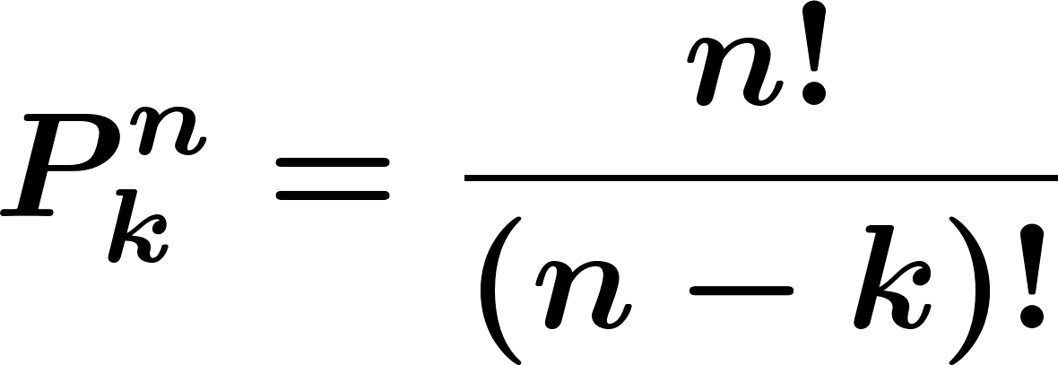
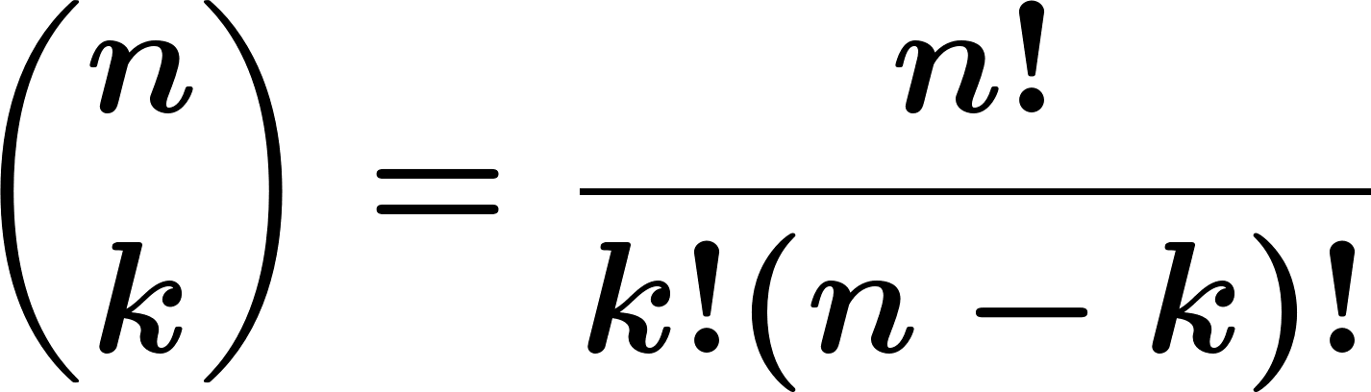
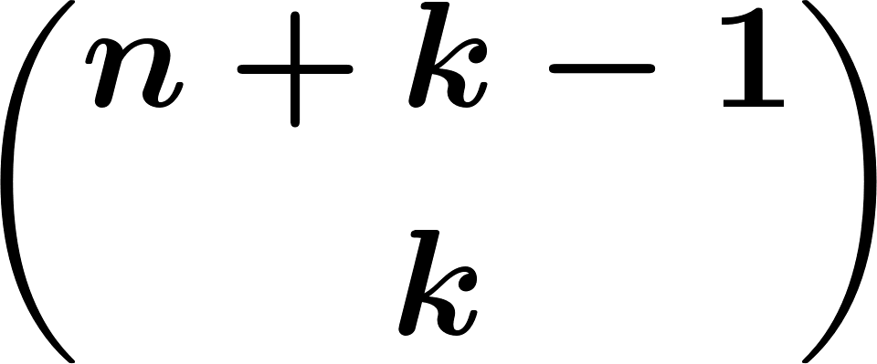
Review
Let's summarize the formulas for the four categories of sampling.
ordered sampling with replacement
ordered sampling without replacement
unordered sampling without replacement
unordered sampling with replacement
Notes:
Now: Slides with Annotation
Next: Slides with Annotation

Slide 33
Summary of this Lesson
You examined the necessity of counting for solving some probability problems. You also focused on methods for counting elements in an efficient manner.
Notes:
Now: Slides with Annotation
Next: Slides with Annotation

Slide 34
Post-work for this Lesson
Complete the homework assignment for Lesson 4: HW#2
Go to the online classroom for details.
Notes:
Now: Slides with Annotation
Next: Slides with Annotation

Slide 35
To Prepare for the Next Lesson
Read Chapter 3 in your online textbook:
https://www.probabilitycourse.com/chapter3/3_1_1_random_variables.php
Complete the Pre-work for Lessons 5-6.
Visit the online classroom for details.
Notes:
Now: Slides with Annotation

